Slide 1
Corona Virus Analysis With SQL
S.Indujah
Data Analyst Intern
MIP-DA-09

Slide 2
Introduction
Analyze the spread and impact of COVID-19 using real-world data.
Dataset of this project 1 is
Province: Geographic subdivision within a country/region.
Country/Region: Geographic entity where data is recorded.
Latitude: North-south position on Earth's surface.
Longitude: East-west position on Earth's surface.
Date: Recorded date of CORONA VIRUS data.
Confirmed: Number of diagnosed CORONA VIRUS cases.
Deaths: Number of CORONA VIRUS related deaths.
Recovered: Number of recovered CORONA VIRUS cases.

Slide 3
Going to answer 16 question regarding this project1 such as
Q1. Write a code to check NULL, values
Q2. If NULL values are present, update them with zeros for all columns.
Q3. check total number of rows
Q4. Check what is start_date and end_date
Q5. Number of month present in dataset
Q6. Find monthly average for confirmed, deaths, recovered
Q7. Find most frequent value for confirmed, deaths, recovered each month
Q8. Find minimum values for confirmed, deaths, recovered per year
Q9. Find maximum values of confirmed, deaths, recovered per year
Q10. The total number of case of confirmed, deaths, recovered each month

Slide 4
Q11. Check how corona virus spread out with respect to confirmed case (Eg.: total confirmed cases, their average, variance & STDEV)
Q12. Check how corona virus spread out with respect to death case per month (Eg.: total confirmed cases, their average, variance & STDEV)
Q13. Check how corona virus spread out with respect to recovered case (Eg.: total confirmed cases, their average, variance & STDEV)
Q14. Find Country having highest number of the Confirmed case
Q15. Find Country having lowest number of the death case
Q16. Find top 5 countries having highest recovered case

Slide 5
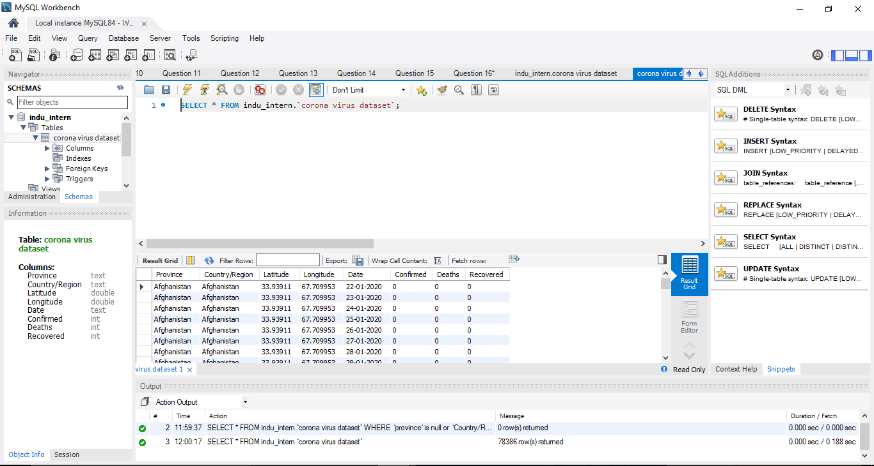
This is the dataset added in the database

Slide 6
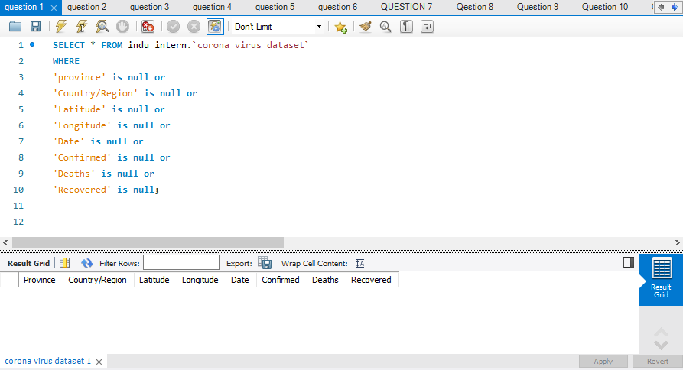
Q1. Write a code to check NULL, values

Slide 7
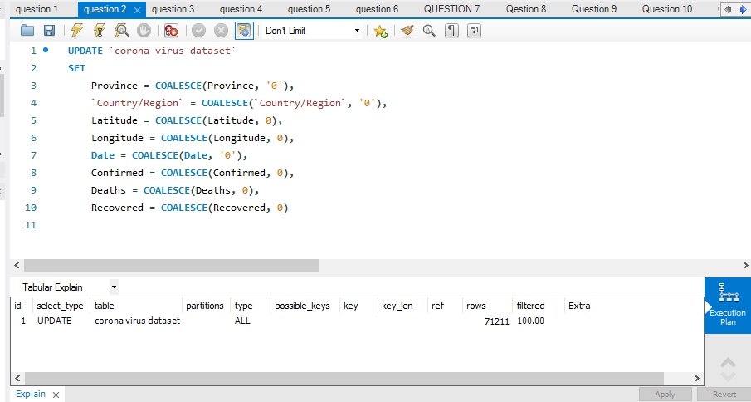
Q2. If NULL values are present, update them with zeros for all columns.

Slide 8
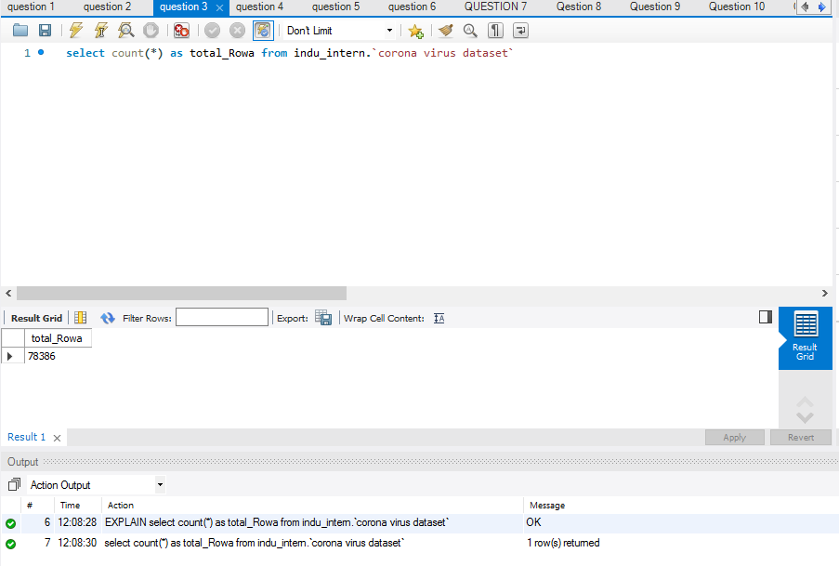
Q3. check total number of rows

Slide 9
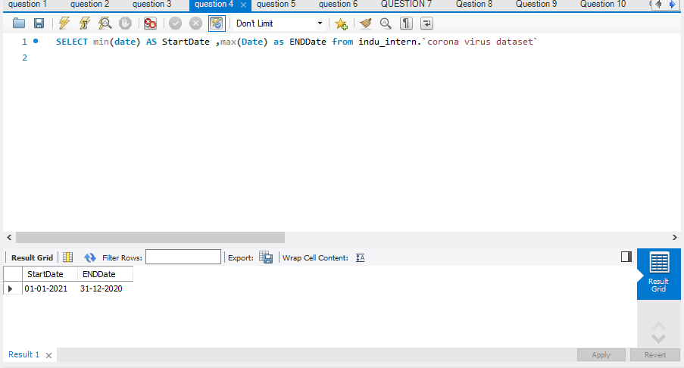
Q4. Check what is start_date and end_date

Slide 10
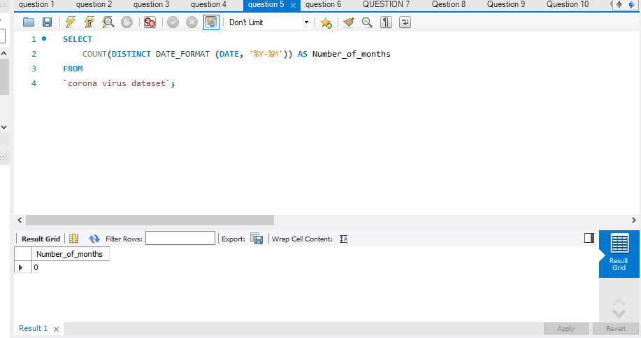
Q5. Number of month present in dataset

Slide 11
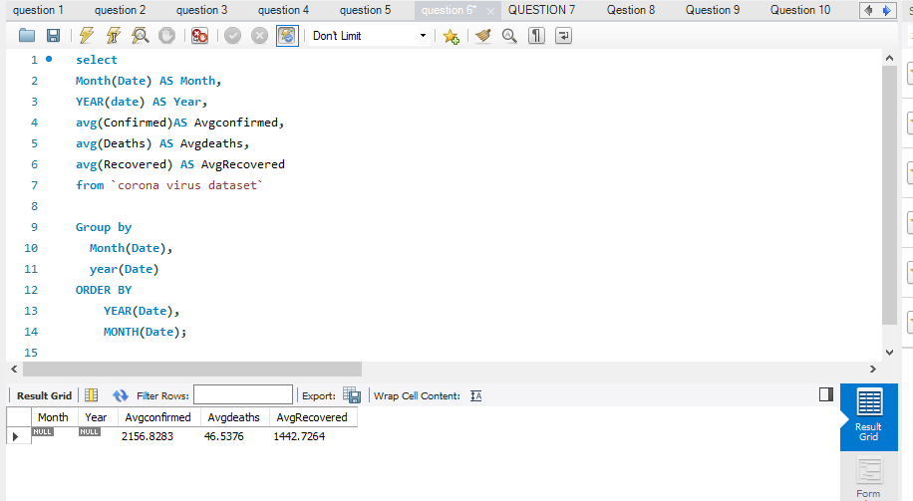
Q6. Find monthly average for confirmed, deaths, recovered

Slide 12
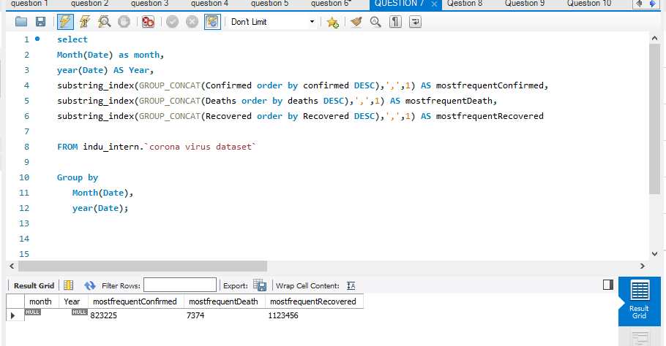
Q7. Find most frequent value for confirmed, deaths, recovered each month

Slide 13
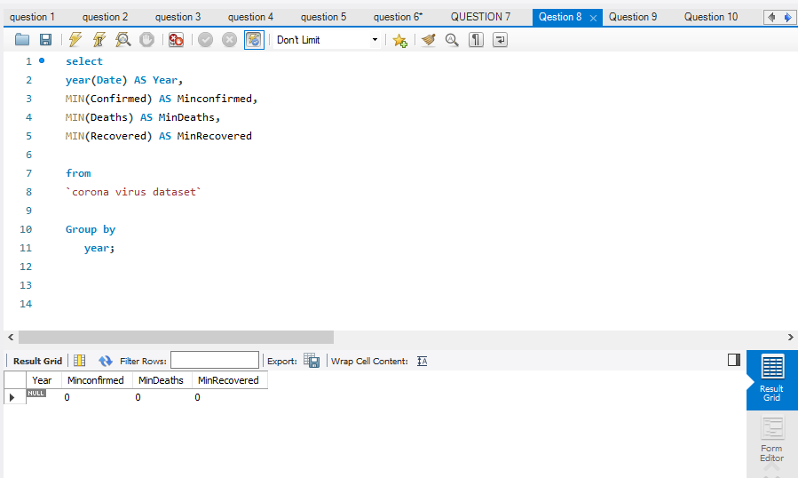
Q8. Find minimum values for confirmed, deaths, recovered per year

Slide 14
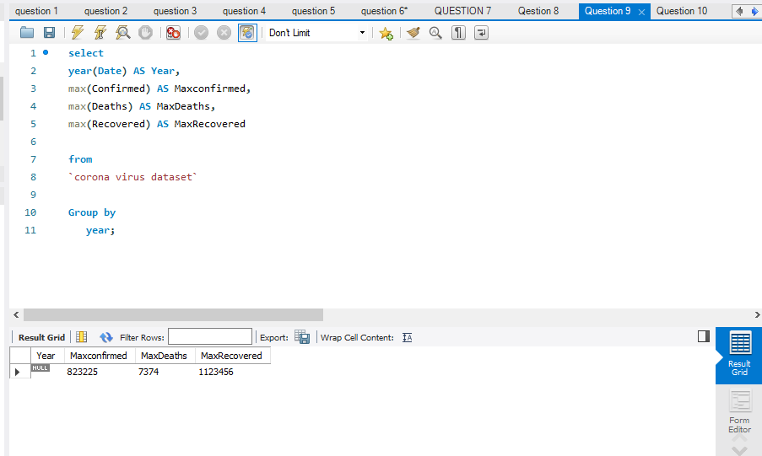
Q9. Find maximum values of confirmed, deaths, recovered per year

Slide 15
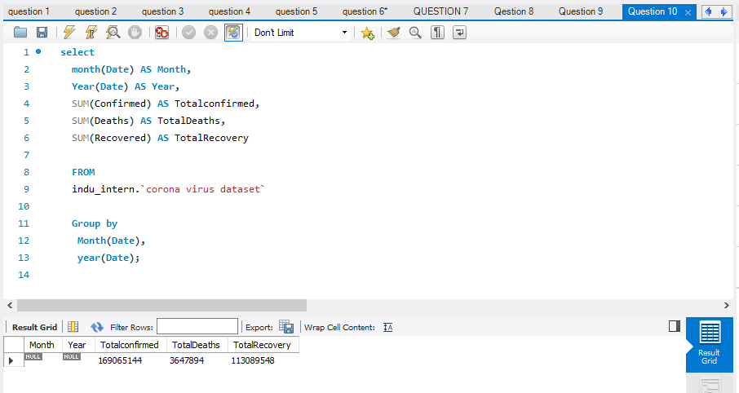
Q10. The total number of case of confirmed, deaths, recovered each month

Slide 16
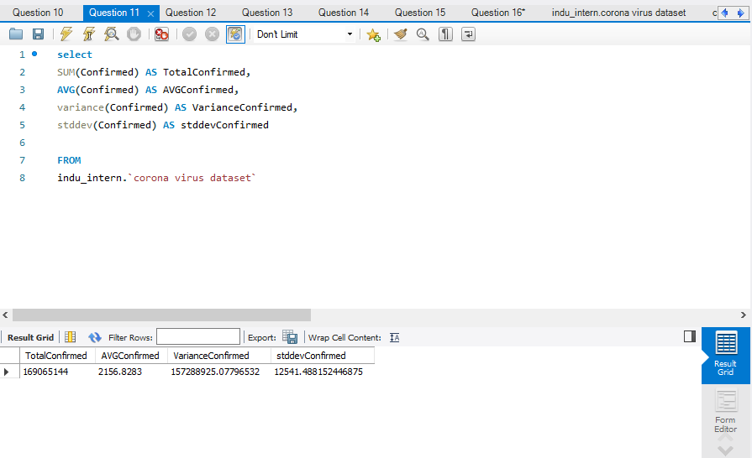
Q11. Check how corona virus spread out with respect to confirmed case

Slide 17
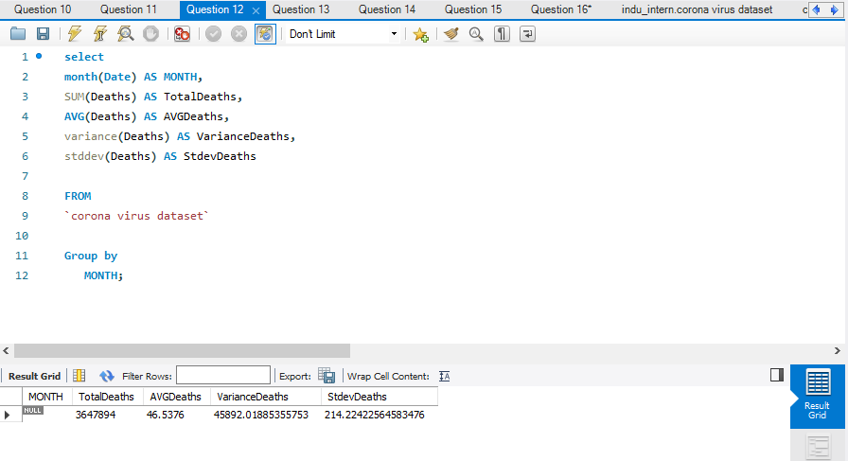
Q12. Check how corona virus spread out with respect to death case per month

Slide 18
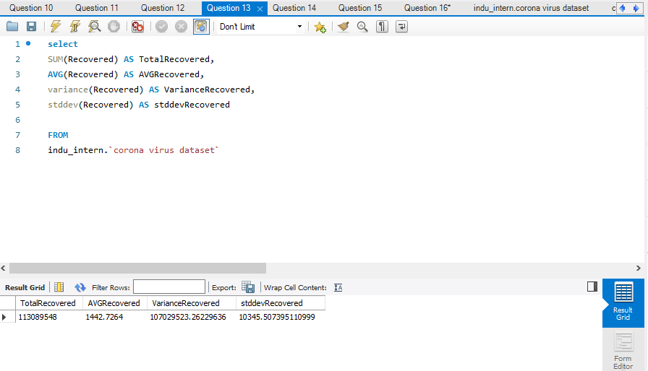
Q13. Check how corona virus spread out with respect to recovered case

Slide 19
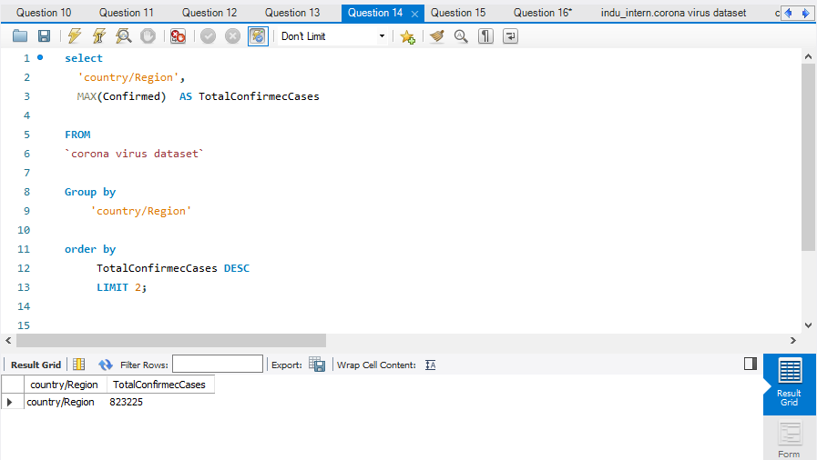
Q14. Find Country having highest number of the Confirmed case

Slide 20
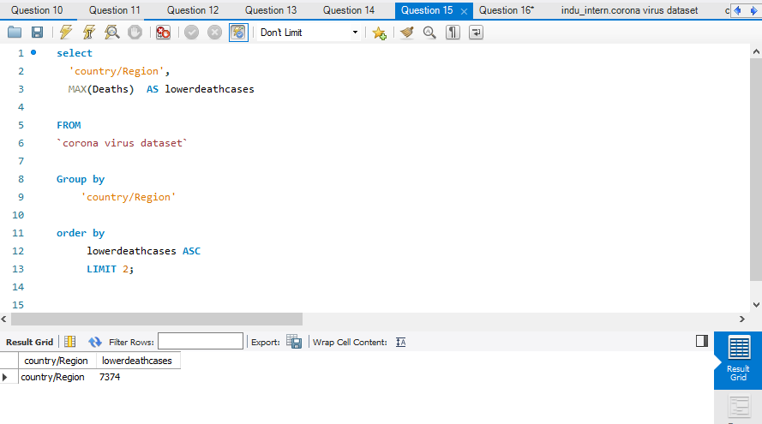
Q15. Find Country having lowest number of the death case

Slide 21
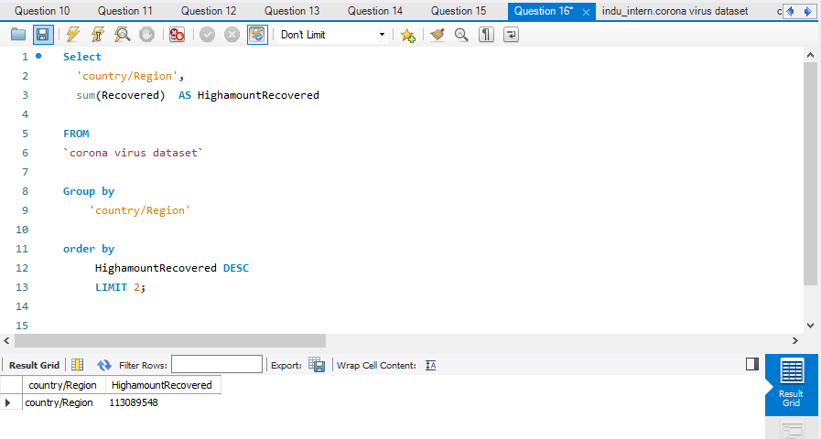
Q16. Find top 5 countries having highest recovered case

Slide 22
THANK YOU

